Slide 1
Autonomous Wheelchair Project Introduction
Max Bronson
Denny Mannakulathil
Oscar Montealegre

Slide 2
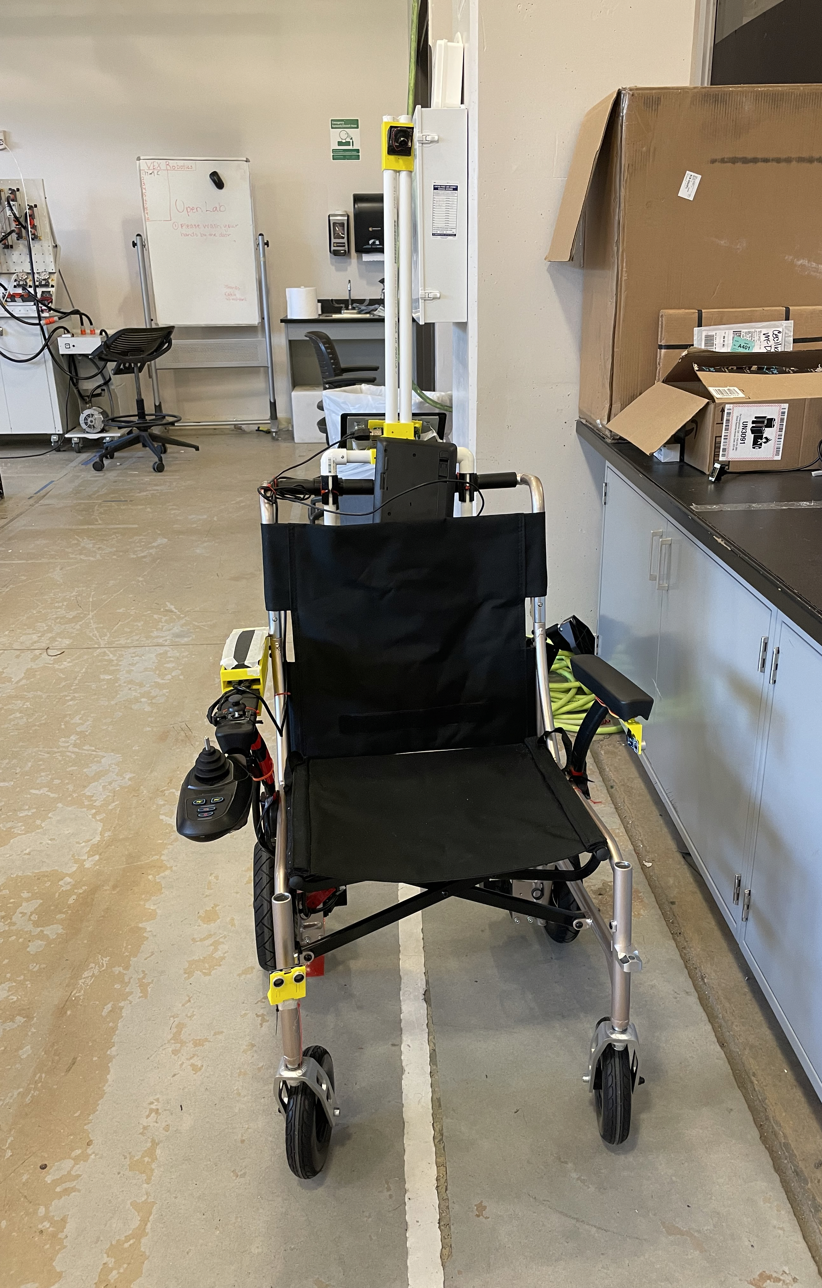
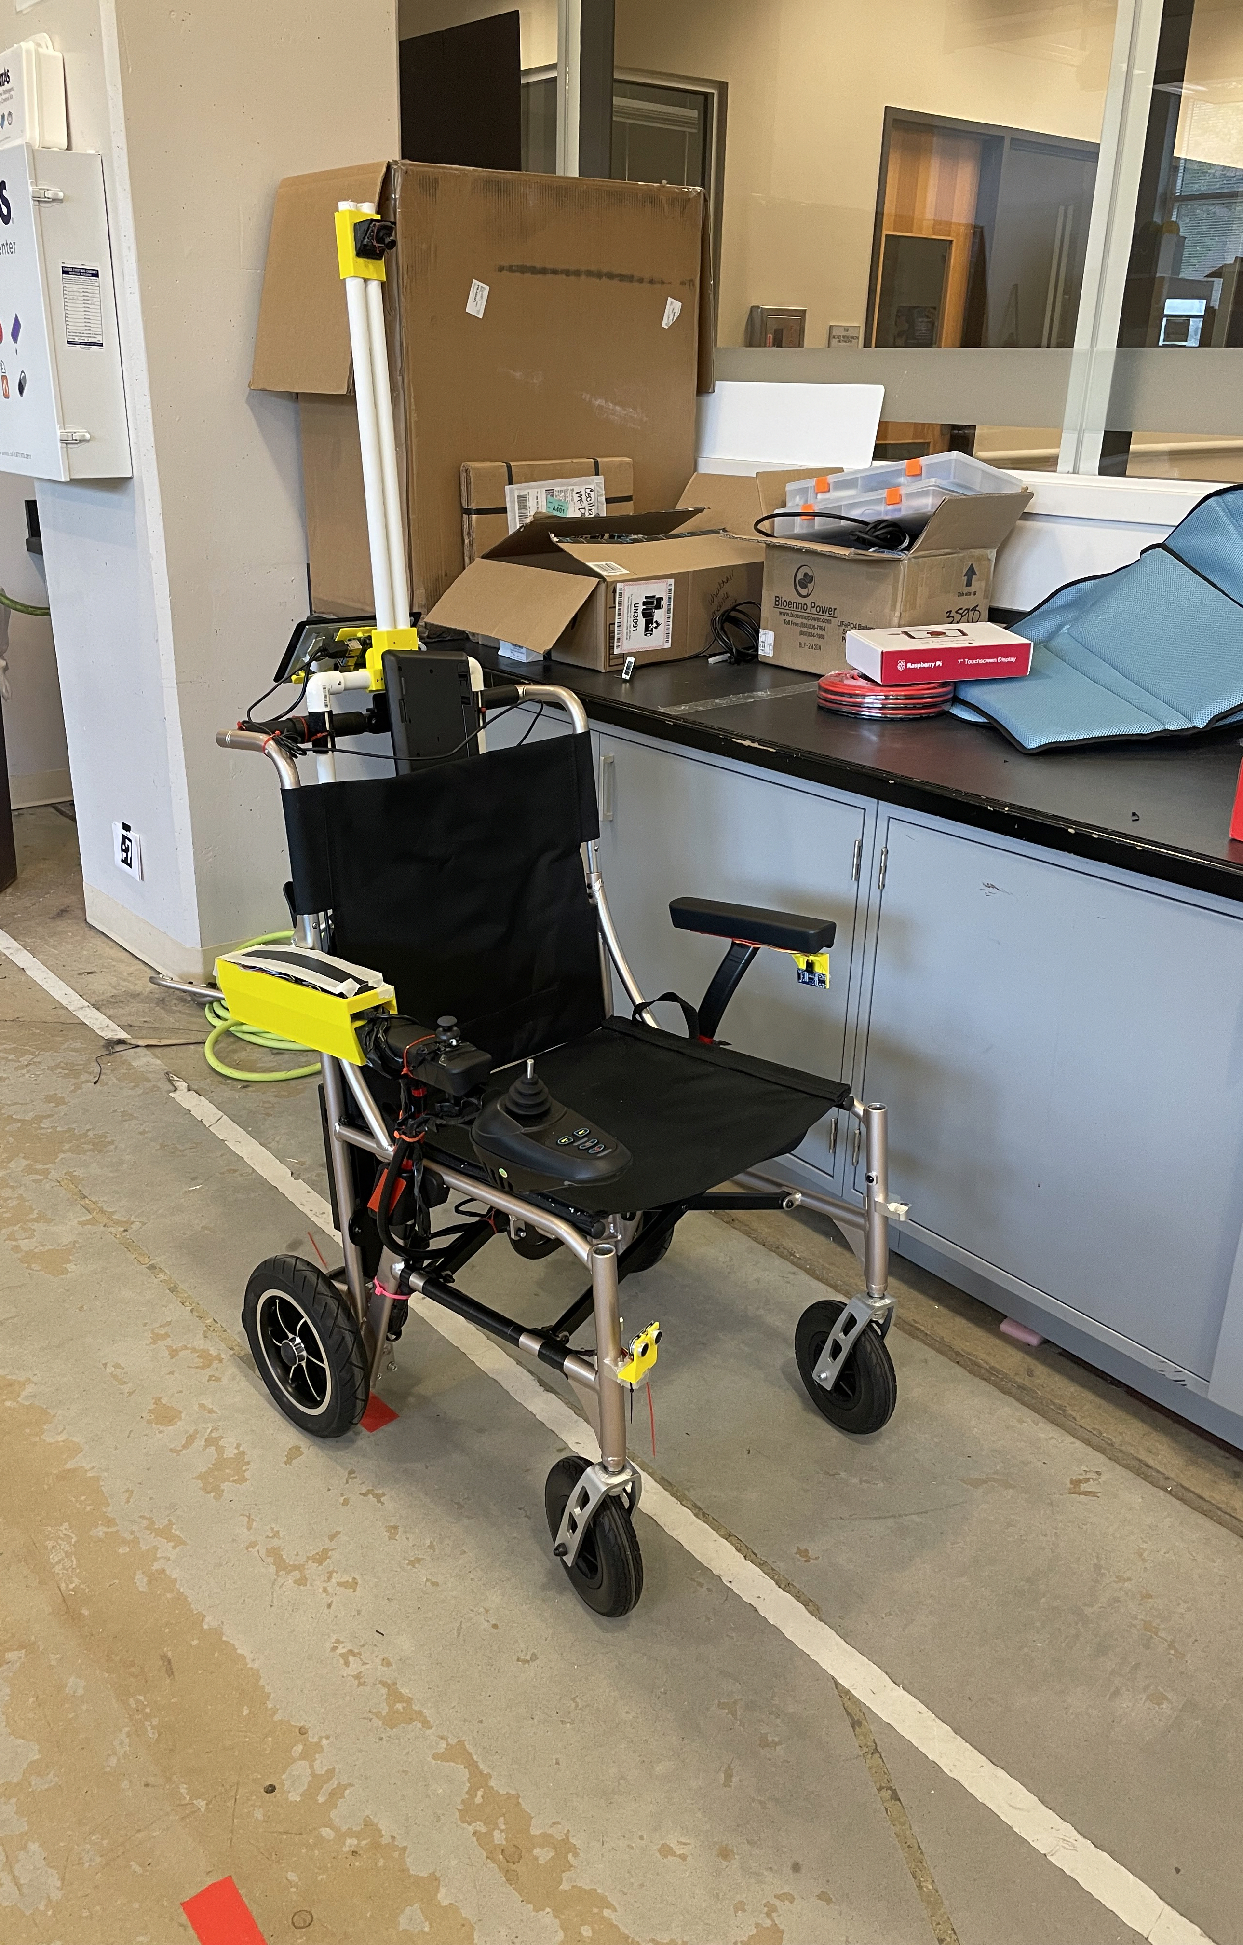
Project Introduction
The intent of the project is to provide mobility to people with motor impairments.
The smart wheelchair currently contains a driving mechanism with the following capabilities:
Manual control via joystick
Bluetooth control via serial communication
Raspberry Pi control via directional commands with serial interfacing
Programmable control via move commands

Slide 3
Project Scope
The scope of this semester's team is to implement image processing/recognition, path planning & SLAM (via sensors) to achieve autonomous mobility. This is to be done with the video camera & the infrared sensor on a Microsoft Kinect; as well as a LiDAR scanner.

Slide 4
Major Parts & Budget
Wheelchair
Raspberry Pi
7” Touchscreen
Arduino Mega
Proximity Sensors
Kinect Camera
LiDAR Scanner
The current design of the wheelchair will require the purchasing or manufacturing of additional mounting materials for the LiDAR Scanner and Kinect Camera.
Total budget ~$100

Slide 5
Team Requirements
ROS, C++ & Python
Hardware (mechanical & electric) Circuit Design & Interfacing
3D Printing
Technical Documentation & Record Keeping
Bronson – Hardware Interfacing & Software Implementation
Mannakulathil – 3-D Printing & Documentation
Montealegre – Software Design & Technical Documentation
Looking for 3D printing & C++ experience

